Slide 1
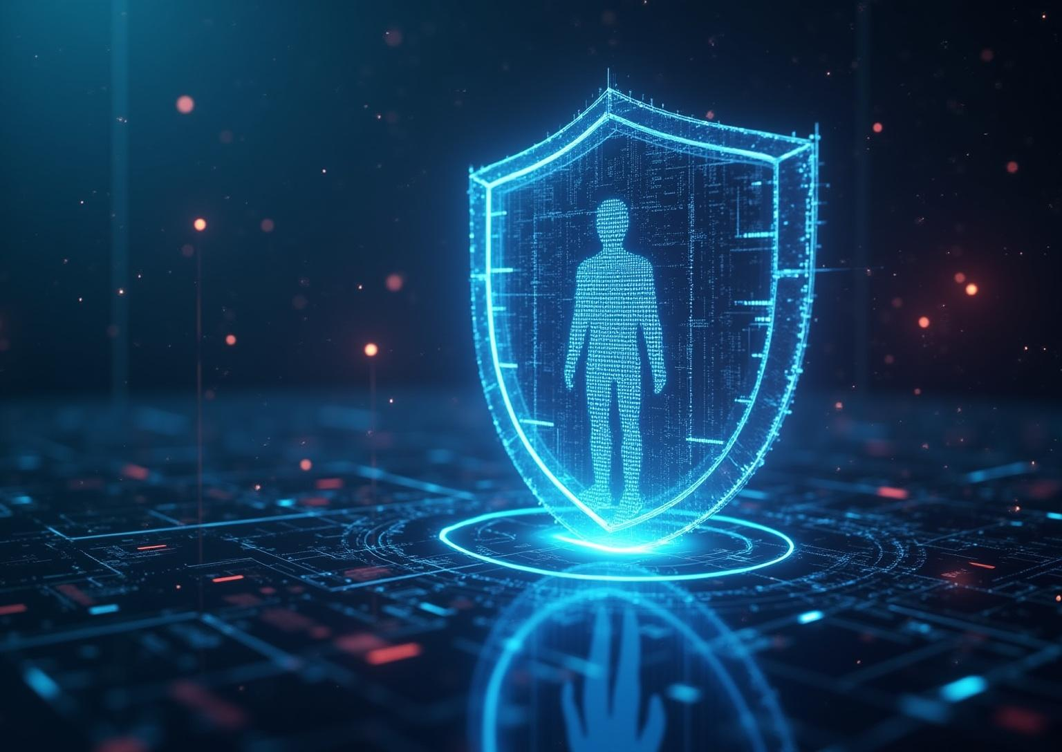
Phishing Training
Enhancing Awareness and Detection Skills

Slide 2
Introduction
Phishing attacks pose significant threats to organizations by exploiting human vulnerabilities. This training aims to provide an overview of phishing, increase awareness of common tactics, and equip employees with the knowledge to recognize and respond effectively to such threats.

Slide 3

Understanding
Phishing

Slide 4
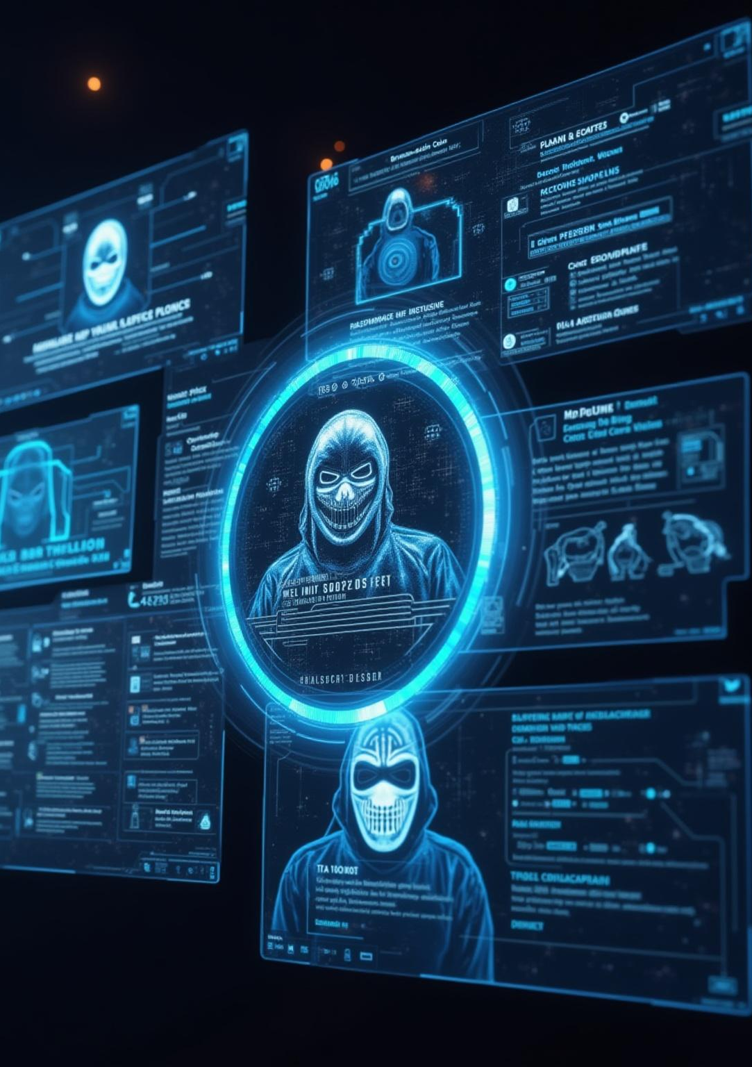
Definition and Types of Phishing
Attacks
Phishing is a cyberattack where attackers impersonate trusted entities to steal sensitive information. Common types include spear phishing, targeting specific individuals, whaling, aimed at executives, and clone phishing, duplicating legitimate emails. Understanding these types is crucial to identifying threats early.

Slide 5
Common Phishing Techniques and Examples
Phishing often uses deceptive emails with urgent messages, malicious links, or fake websites to trick users. Examples include fake password reset requests and fraudulent invoices. Recognizing these tactics helps prevent data breaches and maintains organizational security.

Slide 6
Recognizing Phishing Indicators
Phishing attempts often exhibit urgent language, requesting immediate action or sensitive information. Be wary of suspicious sender addresses, unexpected attachments, and hyperlinks that do not match their visible text. Look for poor grammar or inconsistencies that indicate the message may be illegitimate. Identifying these signs early is critical to preventing security breaches.

Slide 7

Phishing Awareness and
Prevention

Slide 8
Best Practices for Email and Online Safety
Always verify the sender before clicking any links or downloading attachments. Use strong, unique passwords and enable multi-factor authentication where possible. Be cautious with unsolicited messages, and avoid sharing personal or financial information via email. Regularly update software to guard against vulnerabilities.

Slide 9
Steps to Take When Suspecting Phishing
If you suspect a phishing attempt, do not respond or click any links. Report the email immediately to your IT or security team using established channels. Delete the suspicious message after reporting. Prompt action minimizes potential damage and helps protect everyone in the organization.

Slide 10

Organizational Policies and Reporting
Procedures
Familiarize yourself with the company’s cybersecurity policies, including protocols for identifying and reporting phishing. Use designated reporting tools or email addresses to notify security personnel. Adhering to these procedures facilitates quick response and containment of threats, ensuring organizational safety.

Slide 11
Conclusions
Phishing poses a serious threat but can be mitigated through awareness and vigilance. Understanding common tactics, recognizing warning signs, and following company policies are essential defenses. Collective responsibility and timely reporting empower organizations to reduce risks and protect valuable data effectively.

Slide 12
THANKS!
Do you have any questions?
youremail@freepik.com
+00 000 000 000
yourwebsite.com
Please keep this slide for attribution

